Slide 1
Managing Subprograms
Notes:
Schedule: Timing Topic
60 minutes Lecture
20 minutes Practice
80 minutes Total

Slide 2
Objectives
After completing this lesson, you should be able to
do the following:
Contrast system privileges with object privileges
Contrast invokers rights with definers rights
Identify views in the data dictionary to manage stored objects
Describe how to debug subprograms by using the DBMS_OUTPUT package
Notes:
Lesson Aim
This lesson introduces you to system and object privilege requirements. You learn how to use the data dictionary to gain information about stored objects. You also learn how to debug subprograms.

Slide 3
Required Privileges
System privileges
DBA grants
CREATE (ANY) PROCEDURE
ALTER ANY PROCEDURE
DROP ANY PROCEDURE
EXECUTE ANY PROCEDURE
Object privileges
Owner grants
EXECUTE
To be able to refer and access objects from a different schema in a subprogram, you must be granted access to the referred objects explicitly, not through a role.
Notes:
System and Object Privileges
There are more than 80 system privileges. Privileges that use the word CREATE or ANY are system privileges; for example, GRANT ALTER ANY TABLE TO green;. System privileges are assigned by user SYSTEM or SYS.
Object privileges are rights assigned to a specific object within a schema and always include the name of the object. For example, Scott can assign privileges to Green to alter his EMPLOYEES table as follows:
GRANT ALTER ON employees TO green;
To create a PL/SQL subprogram, you must have the system privilege CREATE PROCEDURE. You can alter, drop, or execute PL/SQL subprograms without any further privileges being required.
If a PL/SQL subprogram refers to any objects that are not in the same schema, you must be granted access to these explicitly, not through a role.
If the ANY keyword is used, you can create, alter, drop, or execute your own subprograms and those in another schema. Note that the ANY keyword is optional only for the CREATE PROCEDURE privilege.
You must have the EXECUTE object privilege to invoke the PL/SQL subprogram if you are not the owner and do not have the EXECUTE ANY system privilege.
By default the PL/SQL subprogram executes under the security domain of the owner.
Note: The keyword PROCEDURE is used for stored procedures, functions, and packages.

Slide 4
Granting Access to Data
Direct access:
Scott
EMPLOYEES
GRANT SELECT
ON employees
TO scott;
Grant Succeeded.
SELECT
Indirect access:
Green
GRANT EXECUTE
ON query_emp
TO green;
Grant Succeeded.
SCOTT.QUERY_EMP
The procedure executes with the privileges of the owner (default).
Notes:
Providing Indirect Access to Data
Suppose the EMPLOYEES table is located within the PERSONNEL schema, and there is a developer named Scott and an end user named Green. Ensure that Green can access the EMPLOYEES table only by way of the QUERY_EMP procedure that Scott created, which queries employee records.
Direct Access
From the PERSONNEL schema, provide object privileges on the EMPLOYEES table to Scott.
Scott creates the QUERY_EMP procedure that queries the EMPLOYEES table.
Indirect Access
Scott provides the EXECUTE object privilege to Green on the QUERY_EMP procedure.
By default the PL/SQL subprogram executes under the security domain of the owner. This is referred to as definer's-rights. Because Scott has direct privileges to EMPLOYEES and has created a procedure called QUERY_EMP, Green can retrieve information from the EMPLOYEES table by using the QUERY_EMP procedure.
Instructor Note
If Green has an EMPLOYEES table, the QUERY_EMP procedure will not reference this table but rather the EMPLOYEES table that Scott’s schema can reference.
There is no code example for this page.

Slide 5
Using Invoker's-Rights
The procedure executes with the privileges of the user.
Scott
EMPLOYEES
CREATE PROCEDURE query_employee
(p_id IN employees.employee_id%TYPE,
p_name OUT employees.last_name%TYPE,
p_salary OUT employees.salary%TYPE,
p_comm OUT
employees.commission_pct%TYPE)
AUTHID CURRENT_USER
IS
BEGIN
SELECT last_name, salary,
commission_pct
INTO p_name, p_salary, p_comm
FROM employees
WHERE employee_id=p_id;
END query_employee;
/
SCOTT.
QUERY_EMPLOYEE
Green
EMPLOYEES
Notes:
Invoker’s-Rights
To ensure that the procedure executes using the security of the executing user, and not the owner, use AUTHID CURRENT_USER. This ensures that the procedure executes with the privileges and schema context of its current user.
Default behavior, as shown on the previous page, is when the procedure executes under the security domain of the owner; but if you wanted to explicitly state that the procedure should execute using the owner's privileges, then use AUTHID DEFINER.
Instructor Note
AUTHID is introduced in Oracle8i. In previous versions of the Oracle server, the behavior was based on definer’s rights as described on the previous page.

Slide 6
Managing Stored PL/SQL Objects
Data dictionary
General
information
Source code
Editor
Parameters
P-code
Compile
errors
Debug
information
DESCRIBE ...
DBMS_OUTPUT
Notes:
Managing Stored PL/SQL Objects

Slide 7
USER_OBJECTS
Column
OBJECT_NAME
OBJECT_ID
OBJECT_TYPE
CREATED
LAST_DDL_TIME
TIMESTAMP
STATUS
Column Description
Name of the object
Internal identifier for the object
Type of object, for example, TABLE, PROCEDURE, FUNCTION, PACKAGE, PACKAGE BODY, TRIGGER
Date when the object was created
Date when the object was last modified
Date and time when the object was last recompiled
VALID or INVALID
*Abridged column list
Notes:
Using USER_OBJECTS
To obtain the names of all PL/SQL stored objects within a schema, query the USER_OBJECTS data dictionary view.
You can also examine the ALL_OBJECTS and DBA_OBJECTS views, each of which contains the additional OWNER column, for the owner of the object.

Slide 8
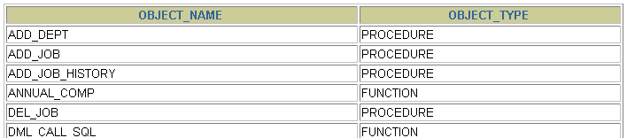
List All Procedures and Functions
SELECT object_name, object_type
FROM user_objects
WHERE object_type in ('PROCEDURE','FUNCTION')
ORDER BY object_name;
…
Notes:
Example
The example in the slide displays the names of all the procedures and functions that you have created.

Slide 9
USER_SOURCE Data Dictionary View
Column
NAME
TYPE
LINE
TEXT
Column Description
Name of the object
Type of object, for example, PROCEDURE, FUNCTION, PACKAGE, PACKAGE BODY
Line number of the source code
Text of the source code line
Notes:
Using USER_SOURCE
To obtain the text of a stored procedure or function, use the USER_SOURCE data dictionary view.
Also examine the ALL_SOURCE and DBA_SOURCE views, each of which contains the additional OWNER column, for the owner of the object.
If the source file is unavailable, you can use iSQL*Plus to regenerate it from USER_SOURCE.
Instructor Note
The Oracle server provides a binary wrapper utility that is discussed in the Advanced PL/SQL course. If the source code has been wrapped, then it cannot be recovered from the USER_SOURCE data dictionary view.

Slide 10
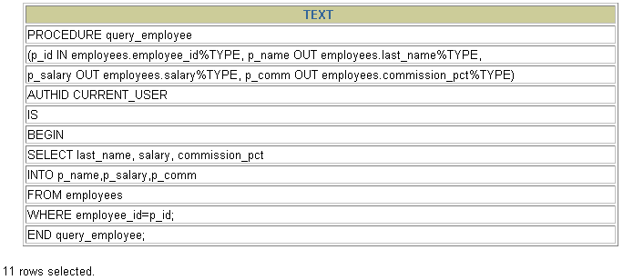
List the Code of Procedures and Functions
SELECT text
FROM user_source
WHERE name = 'QUERY_EMPLOYEE'
ORDER BY line;
Notes:
Example
Use the USER_SOURCE data dictionary view to display the complete text for the QUERY_EMPLOYEE procedure.

Slide 11
USER_ERRORS
Column
NAME
TYPE
SEQUENCE
LINE
POSITION
TEXT
Column Description
Name of the object
Type of object, for example, PROCEDURE, FUNCTION, PACKAGE, PACKAGE BODY, TRIGGER
Sequence number, for ordering
Line number of the source code at which the error occurs
Position in the line at which the error occurs
Text of the error message
Notes:
Obtaining Compile Errors
To obtain the text for compile errors, use the USER_ERRORS data dictionary view or the SHOW ERRORS iSQL*Plus command.
Also examine the ALL_ ERRORS and DBA_ ERRORS views, each of which contains the additional OWNER column, for the owner of the object.

Slide 12
Detecting Compilation Errors: Example
CREATE OR REPLACE PROCEDURE log_execution
IS
BEGIN
INPUT INTO log_table (user_id, log_date) -- wrong
VALUES (USER, SYSDATE);
END;
/
Notes:
Example
Given the above code for LOG_EXECUTION, there will be a compile error when you run the script for compilation.

Slide 13
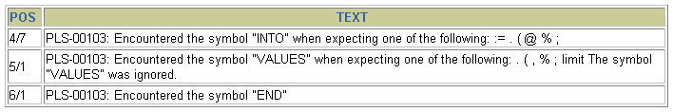
List Compilation Errors by Using USER_ERRORS
SELECT line || '/' || position POS, text
FROM user_errors
WHERE name = 'LOG_EXECUTION'
ORDER BY line;
Notes:
Listing Compilation Errors, Using USER_ERRORS
The SQL statement above is a SELECT statement from the USER_ERRORS data dictionary view, which you use to see compilation errors.

Slide 14
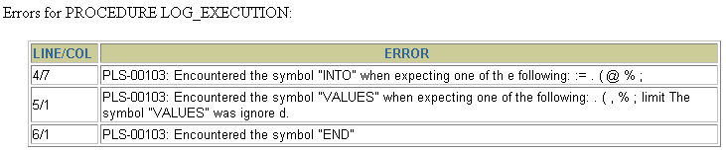
List Compilation Errors by Using
SHOW ERRORS
SHOW ERRORS PROCEDURE log_execution
Notes:
SHOW ERRORS
Use SHOW ERRORS without any arguments at the SQL prompt to obtain compilation errors for the last object you compiled.
You can also use the command with a specific program unit. The syntax is as follows:
SHOW ERRORS [{FUNCTION|PROCEDURE|PACKAGE|PACKAGE
BODY|TRIGGER|VIEW} [schema.]name]
Using the SHOW ERRORS command, you can view only the compilation errors that are generated by the latest statement that is used to create a subprogram. The USER_ERRORS data dictionary view stores all the compilation errors generated previously while creating subprograms.

Slide 15
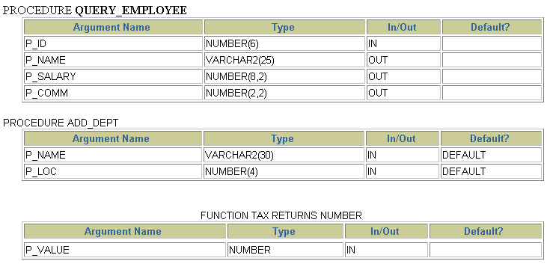
DESCRIBE in iSQL*Plus
DESCRIBE query_employee
DESCRIBE add_dept
DESCRIBE tax
Notes:
Describing Procedures and Functions
To display a procedure or function and its parameter list, use the iSQL*Plus DESCRIBE command.
Example
The code in the slide displays the parameter list for the QUERY_EMPLOYEE and ADD_DEPT procedures and the TAX function.
Consider the displayed parameter list for the ADD_DEPT procedure, which has defaults. The DEFAULT column indicates only that there is a default value; it does not give the actual value itself.
Instructor Note (for page 11-16)
In Oracle8i DBMS_DEBUG provides a way to debug server-side subprograms. To do this type of debugging, it is necessary to have two database sessions: one session to run the code in debug mode (the target session), and a second session to supervise the target session (the debug session). DBMS_DEBUG is a PL/SQL application programming interface (API) to the PL/SQL debugger layer and is primarily intended to implement server-side debuggers.

Slide 16
Debugging PL/SQL Program Units
The DBMS_OUTPUT package:
  Accumulates information into a buffer
  Allows retrieval of the information from the buffer
Autonomous procedure calls (for example, writing the output to a log table)
Software that uses DBMS_DEBUG
  Procedure Builder
  Third-party debugging software
Notes:
Debugging PL/SQL Program Units
Different packages that can be used for debugging PL/SQL program units are shown in the slide.
You can use DBMS_OUTPUT packaged procedures to output values and messages from a PL/SQL block. This is done by accumulating information into a buffer and then allowing the retrieval of the information from the buffer. DBMS_OUTPUT is an Oracle-supplied package. You qualify every reference to these procedures with the DBMS_OUTPUT prefix.
Benefits of Using DBMS_OUTPUT Package
This package enables developers to follow closely the execution of a function or procedure by sending messages and values to the output buffer. Within iSQL*Plus use SET SERVEROUTPUT ON or OFF instead of using the ENABLE or DISABLE procedure.
Suggested Diagnostic Information
Message upon entering, leaving a procedure, or indicating that an operation has occurred
Counter for a loop
Value for a variable before and after an assignment
Note: The buffer is not emptied until the block terminates.
You can debug subprograms by specifying autonomous procedure calls and store the output as values of columns into a log table.
Debugging using Oracle Procedure Builder is discussed in Appendix C. Procedure Builder uses a Oracle-specified debugging package called DBMS_DEBUG.

Slide 17
Summary
Scott
USER_SOURCE
Source
code
Compile
P-code
Compile
errors
USER_ERRORS
Privileges
Green
Notes:
Summary
A user must be granted the necessary privileges to access database objects through a subprogram.
Take advantage of various data dictionary views, SQL commands, iSQL*Plus commands, and
Oracle-supplied procedures to manage a stored procedure or function during its development cycle.

Slide 18
Summary
Execute
Debug
information
Notes:
Summary (continued)
Query the data dictionary.
List all your procedures and functions, using the USER_OBJECTS view.
List the text of certain procedures or functions, using the USER_SOURCE view.
Prepare a procedure: Recreate a procedure and display any compile errors automatically.
Test a procedure: Test a procedure by supplying input values; test a procedure or function by displaying output or return values.

Slide 19
Practice 11 Overview
This practice covers the following topics:
Re-creating the source file for a procedure
Re-creating the source file for a function
Notes:
Practice 11 Overview
In this practice you will re-create the source code for a procedure and a function.

Slide 20
Notes:
Practice 11
Suppose you have lost the code for the NEW_EMP procedure and the VALID_DEPTID function that you created in lesson 10. (If you did not complete the practices in lesson 10, you can run the solution scripts to create the procedure and function.)
Create an iSQL*Plus spool file to query the appropriate data dictionary view to regenerate the code.
Hint:
SET -- options ON|OFF
SELECT -- statement(s) to extract the code
SET -- reset options ON|OFF
To spool the output of the file to a .sql file from iSQL*Plus, select the Save option for the Output and execute the code.

